Slide 1

OTC course
Prepared by Dr.Aya altaweel
Clinical pharmacist and BPS certified
Certified fitness nutrition specialist
Compounding pharmacist & First aid trainer

Slide 2
Objectives of the OTC course
How to be a professional pharmacist
How to dispense drugs
When to refer the doctor
How to read prescribtion
How to answer cases
In this course you will not need other source for study

Slide 3
Why the OTC course in drug & tube
Our material is updated
you won’t face problems in the course
Ask your Questions anytime
You will not found this course and the value in any another academy
This course is presented to “Pharmacist only”

Slide 4
Outline
Antibiotics
Penicillin's
Cephalosporins
Carbepenems
Aminoglycosides
Macrolides
Fluroquinolones
Antivirals
Antifungals
Anti-helmintics

Slide 5

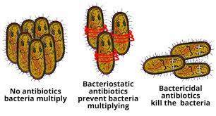
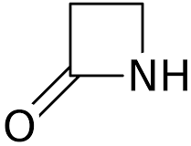
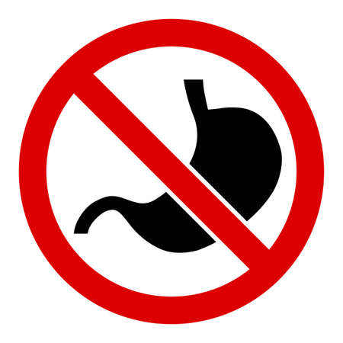

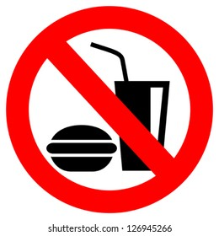

Symbols in this lecture
-bacteriostatic - bacteriocidal -B-lactam antibiotic - not gastric
-gastric (orally) - before meal - after meals

Slide 6
Anti-biotics

Slide 7
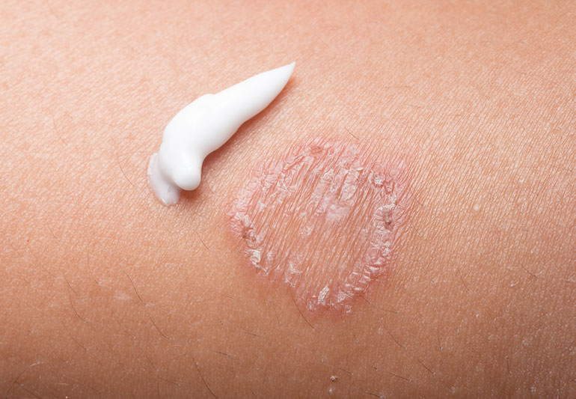
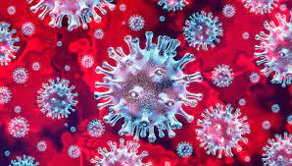
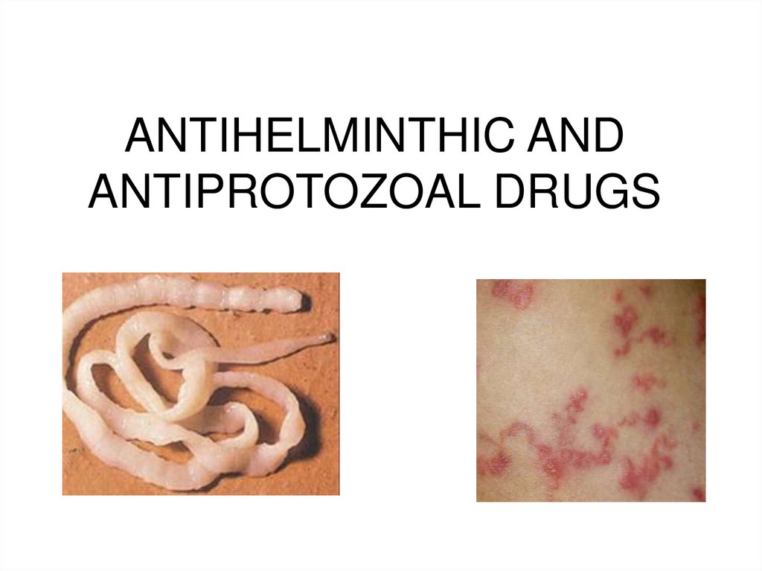
Important definitions
Anti-microbial :
Include anti-viral , anti-fungal , anti-protozoal , antibiotics
Antibiotics :
a substance extracted from miroorganism that is effective in killing other microorganisms
Chemotheraputics
The use of any chemical (drug) to treat any disease or condition
Notes:
These drugs are used in treatment of infectious diseases wether bacteria , viral , fungal or parasetic

Slide 8
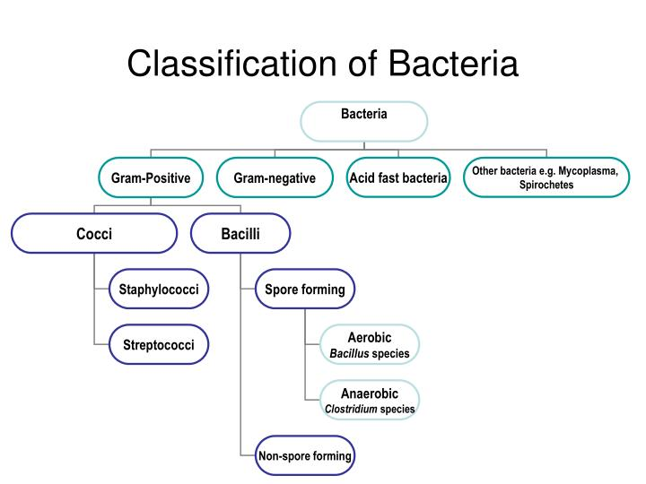
Bacteria

Slide 9
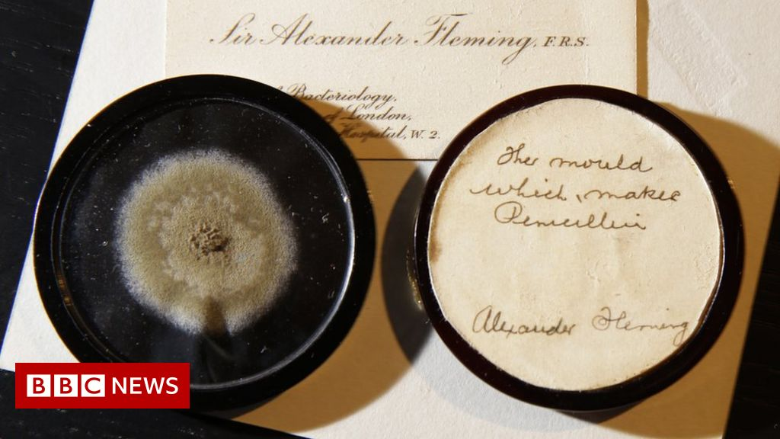
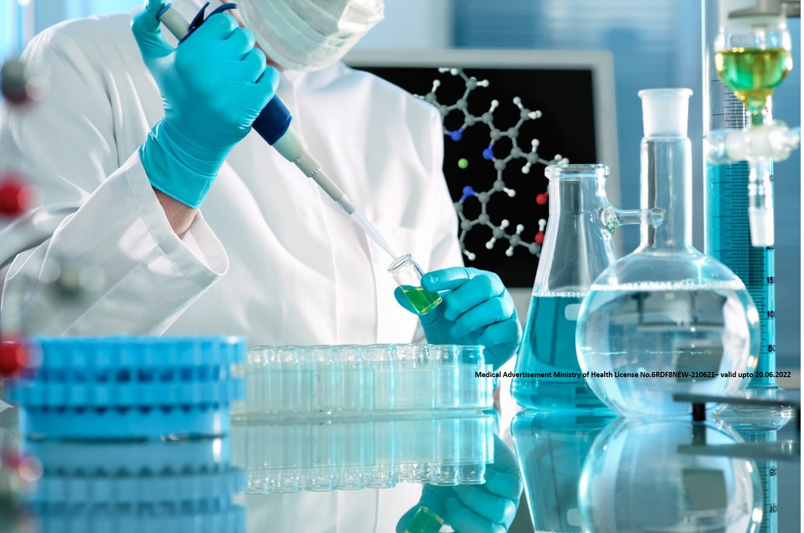

Slide 10
Anti-bacterial (antibiotics)
Antibacterial can be derived from microbe (natural=antibiotic)
Penicillin
Antibacterial extracted from microbe and modification occurs (semi-synthetic)
Ampicilin
Synthetic Antibacterial
Quinolones
Antibiotics can either be bacteriostatic or bactericidal

Slide 11
What is the deference between ?
Bacteriostatic
Bactericidal

Slide 12
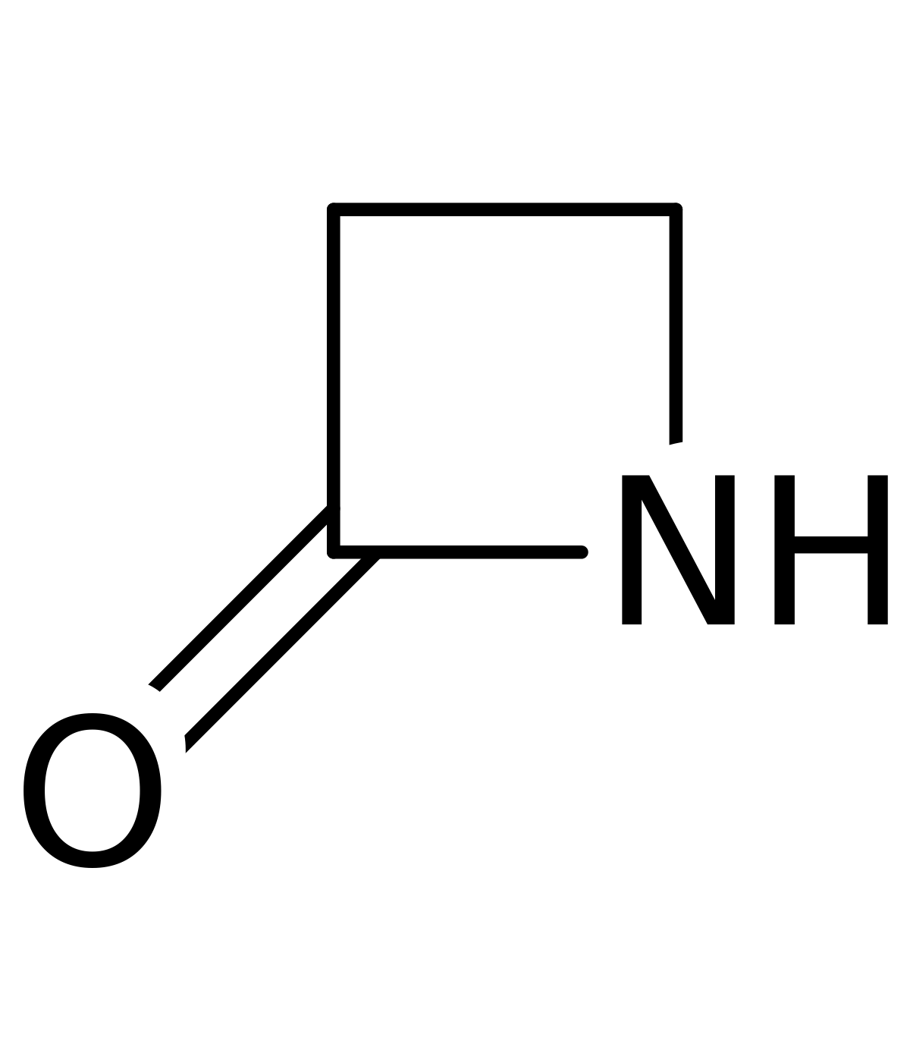
Antibiotic classification :
Penicillins
Cephalosporins
Monobactam
Carbepenems
Aminoglycosides
Macrolides
Fluroquinolones
B-lactam antibiotic
Why????

Slide 13
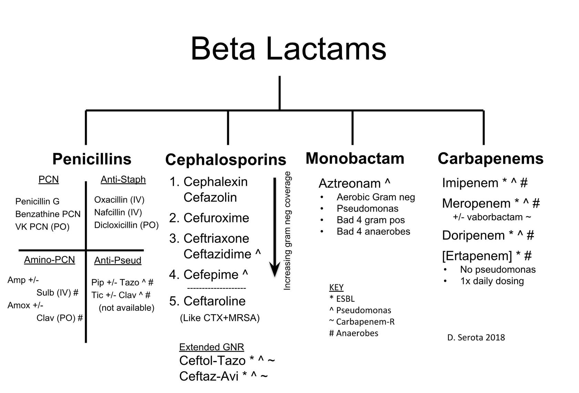

Slide 14
B-lactam antibiotics
They’re considered to be bactericidal antibiotics
They bind to penicillin binding protein (مجموعة من البروتينات اللي بتمسك في البنسلين ) thus
-Decrease transpeptidase enzyme which is responsible for the cross-linking of peptidoglycans, which is the final step in cell wall synthesis so --------------------------------→ cell wall synthesis
-activate autolysins so -------→ lysis of the cell wall
-bacteria absorbs the water due it’s interior high osmotic pressure thus ---------→ rupture and death of the microbe
-they activate the growing bacteria rather than the resting ones
3- selectivity : human cells doesn't have peptidoglycan wall

Slide 15
B-lactam antibiotics
Beta-lactam antibiotics are among the most commonly prescribed drugs, grouped together based upon a shared structural feature, the beta-lactam ring. Beta-lactam antibiotics include:
Penicillins
Cephalosporins
Cephamycins
Carbapenems

Slide 16
Mechanisms of bacterial resistance
Decreased penetration to the target site and efflux — The outer membrane of gram-negative bacilli provides an efficient barrier to the penetration of beta-lactam antibiotics to their target penicillin-binding proteins (PBPs) in the bacterial cytoplasmic membrane. Beta-lactams usually must pass through the hydrophilic porin protein channels in the outer membrane of gram-negative bacilli to reach the periplasmic space and cytoplasmic membrane. The permeability barrier of the outer membrane is a major factor in the relative intrinsic resistance of Pseudomonas aeruginosa to many beta-lactam antibiotics. Mutations that result in decreased amounts of porin channels, those that increase the amounts of native active efflux pumps, or both can contribute to acquired resistance to beta-lactams

Slide 17
Mechanisms of bacterial resistance
Alteration of the target site — The target sites for the beta-lactams are the PBPs in the cytoplasmic membrane. Alterations in PBPs may influence their binding affinity for beta-lactam antibiotics and therefore the sensitivity of the altered bacterial cell to inhibition by these antibiotics. Such a mechanism is responsible for penicillin resistance in pneumococci , methicillin (oxacillin) resistance in staphylococci , and for bacteria with increasing intrinsic resistance to beta-lactams, such as gonococci, enterococci, and Haemophilus influenzae

Slide 18
Mechanisms of bacterial resistance
Inactivation by a bacterial enzyme — Production of beta-lactamases is a major mechanism of resistance to the beta-lactam antibiotics in clinical isolates. Such bacterial enzymes may cleave predominantly penicillin's (penicillinases), cephalosporins (cephalosporinases), or both (beta-lactamases). Their production may be encoded within the bacterial chromosome (and hence be characteristic of an entire species) or the genes may be acquired on a plasmid or transposon (and hence be characteristic of an individual strain rather than the species). Bacteria may synthesize the beta-lactamase constitutively (as for many plasmid-mediated enzymes)

Slide 19
Adverse effects
IgE-mediated allergic reactions — Type I, IgE-mediated reactions present with various combinations of pruritus, flushing, urticaria, angioedema, wheezing, laryngeal edema, hypotension, and/or anaphylaxis. Symptoms usually appear within four hours of drug administration and may begin within minutes. When the allergy first develops, the initial symptoms may appear during the later days of treatment and then escalate rapidly
Serum sickness — Serum sickness is a late allergic reaction characterized by fever, rash (usually urticarial), adenopathy, arthritis, and occasionally glomerulonephritis. It is associated with circulating immune complexes and has been reported with all of the beta-lactam antibiotics. Each of the beta-lactam antibiotics is also capable of causing drug fever
Dermatologic reactions — A variety of rashes occur with the beta-lactam antibiotics, of which morbilliform rash is the most common. Erythema multiforme is an acute eruption characterized by distinctive target skin lesions and diagnostic histology; when the mucosal surfaces are involved as well, the reaction is termed Stevens-Johnson syndrome. Exfoliative dermatitis is a severe skin disorder with generalized erythema and scaling. Toxic epidermal necrolysis is an acute severe reaction with widespread erythema and detachment of the epidermis; there may be a positive Nikolsky sign. Hypersensitivity angiitis is a small vessel vasculitis involving mainly the venules of the skin and characterized by palpable purpura. The beta-lactam antibiotics may also cause photosensitivity reactions
Notes:
طب إيه هيا الآثار الجانبية ؟ ، اول حاجة ال IGE mediated allergic reations النوع الأول بيكون موجود مع العديد من المشاكل زي الأرتيكاريا ، انفاض ضغط الدم ، وانتفاخ الوش ، والهرش ، والأعراض دي بتبان في خلال أول ساعات من إستخدام الدوا وممكن كمان تبدأ في أول كام دقيقة من أخد الدوا ،، الأعراض المبدئية ممكن انها تظهر خلال الأيام الأخيرة من العلاج وتظهر بسرعة ، تاني حاجة بتكون ال serum sickness وده بيكون عبارة عن أثر تحسسي بيظهر متأخر وبيكون معروف بالسخونية ، الهرش ، آلام في المفاصل او ممكن يعمل glomerulonephritis ودي بتكون مشكلة في الكلى ، ودي بتكون مرتبطة مع ال immune complexes وكل مضادات البيتا لاكتام ممكن انها تعمل مشكلة السخونية ، تالت نوع من أنواع المشاكل اللي بتعملها البيتا لاكتام هيا ال dermatologic reactions فيه عدد كبير من الحساسية ممكن انه يحصل مع استخدامات مضادات البيتا لاكتام ، زي ال Erythema multiforme ودي بتكون عبارة عن طفح جلدي حاد ، أما الmucosal surfaces تدخل مع بعضها ال reaction هنا بنسميه SJS، ال exfoliative dermatitis بتكون عبارة عن مشكلة كبيرة في الجلد بيكون فيها احمرار ويبدأ الجلد يتقشر من بعضه ، TENبيكون عبارة عن حالة خطيرة وبيكون الإحمرار ده واسع فيها وتبدأ ال epiderms أو الطبقة الخارجية للجلد تتقشر خالص ، البيتا لاكتام كمان ممكن انها تعمل حساسية ضد الضوء

